Slide 1
UNIT 5

Slide 2
Marketing in Social Entrepreneurship
Marketing for social entrepreneurship is a social and managerial process in which individuals and groups receive what they want and need through the exchange of products and values. The task of marketing is to identify and define specific markets for specific products.

Slide 3
The Four Ps of the marketing mix
The Four P’s is a common tool to analyze the marketing mix of the business venture. The four P’s represent the product, price, placement and promotion and aims at comprising all aspects of the production and deliverance processes in a simple and convenient manner.
The product or service that is created through a user-driven design is the core of the marketing strategy.

Slide 4
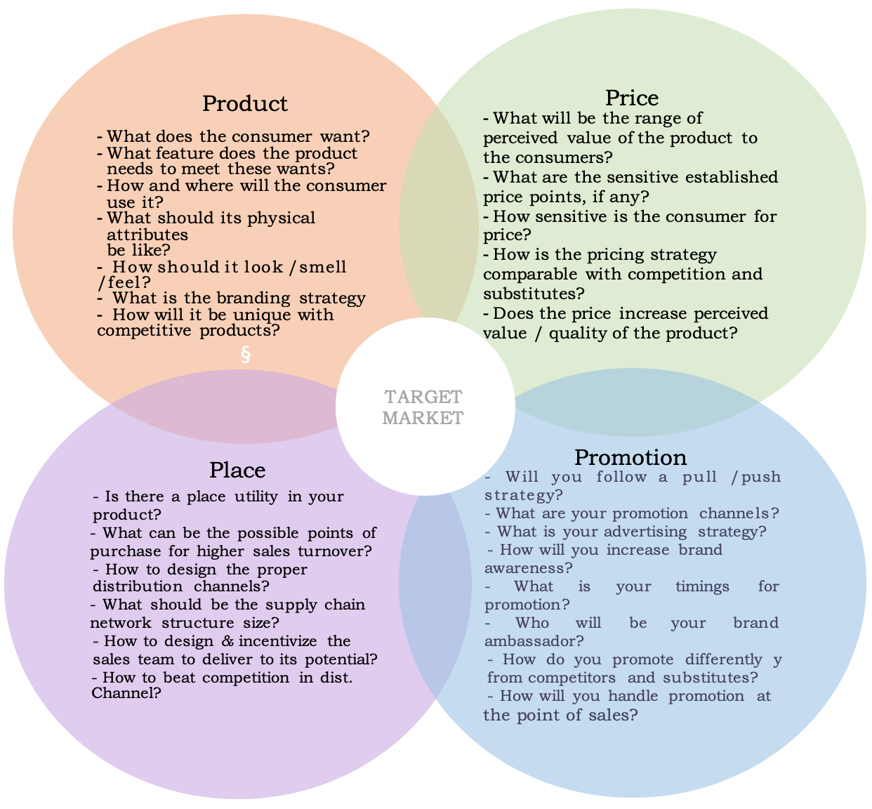
The Four Ps of the marketing mix

Slide 5
The Four Ps of the marketing mix
The price is a key element that determines not only the competitiveness of the product/service but also its accessibility to the audience, thus reflecting the social outcome of the venture.
The goal of the social enterprise is to make the product or service as accessible as possible, and that means offering the value needed to produce the desired social outcome in the most affordable manner.
In the same time the quality should not be compromised in order to secure lower price. Optimizing the costs of production is the key to success in both: maximizing customer benefits and ensuring financial sustainability of the enterprise.
But affordability does not depend only on managing manufacturing costs. It can also be attained through external financing, creative payment or distribution schemes. These multiple aspects should all be reflected in the marketing and the business plan.
The cost refers to what you’re paying to produce, promote, and distribute your product or service, while the pricing refers to what you’re charging your customers or clients.

Slide 6
The Four Ps of the marketing mix
In certain cases, the price for the product or service could be placed below the cost of production, if other activities or sources of revenue could subsidize it and ensure the financial viability of the enterprise.
Placement refers to the distribution channel that are employed in delivering the product and the service to the end users. Accessing more people or larger target audience is a key factor for the success of the social enterprise.
Promotion focus on building relationship with the potential customers. Effective promotion heavily relies on understanding customers’ behaviors and preferences and on resources that the company has for advertising

Slide 7
Social Sector
The term social sector refers to that part of social and economic activity done for the purpose of benefiting society and which is funded, in part or whole, through charitable gifts. Other common terms relating to those organizations in this sector are nonprofit, mission-based sector, non-governmental organizations, and tax-exempt organizations.
Two main approaches to the definition may be identified: one views social sectors from a Human Resource Development point of view; the other takes the Human Development Approach.
The Human Resource Development Approach
The human Resource Development Approach emphasizes investment in Education, health and nutrition as a means of enhancing the quality of human capital which may be defined as “the stock of skills and productive knowledge embodied in people”
Human Development Approach
The alternative approach to social sector is that of human development. The term has been defined as ‘the process of enlarging people’s choices’. The concept encompasses empowerment, cooperation, equity in basic capabilities and opportunities, sustainability and security. In this approach people occupy center stage, and measures such as education, health and nutrition are emphasized from their intrinsic value and not for their role in enhancing their basic capabilities of people.

Slide 8
Social Innovation
Social innovation refers to the design and implementation of new solutions that imply conceptual, process, product, or organizational change, which ultimately aim to improve the welfare and wellbeing of individuals and communities.
Many initiatives undertaken by the social economy and by the civil society have proven to be innovative in dealing with socio-economic and environmental problems, while contributing to economic development.
Broadly, the term social innovation has been used to describe:
Societal transformation
A model of organizational management
Social entrepreneurship
The development of new products, services and program
A model of governance, empowerment and capacity-building

Slide 9
SOCIAL INNOVATION ACROSS FOUR SECTORS
Social innovation does not refer to any particular sector of the economy, but to innovation in the creation of social outputs, regardless of where they emanate. As such, social innovation can take place in all four sectors:
The non-profit sector – for example, taking youth at risk and pairing them with university graduates in challenging schools to inspire, motivate and encourage them to become worthy citizens. Another initiative is offering homeless people a home by teaching them to work with recycled materials or giving them a job renovating and reselling donated furniture, enabling them to become home owners.
The public sector – both in terms of policies and service/business models. Examples include providing unemployed youth with entry-level positions (including job shadowing, learnerships or apprenticeships) after a process of job readiness or skills development and government providing incentives for companies and employers to provide opportunities for unemployed, uneducated youth.
The private sector – for example, ethical finance, markets for social or environmental goods, or what the social entrepreneur and civil society leader Muhammad Yunus calls “social businesses”. In essence, to create new forms of businesses that offer social return on investment as opposed to pure for-profit businesses.
The informal sector – which plays a critical role in the creation of social movements such as the slow food movement, which started in Italy but has swept across the globe. Another example is restaurants using surplus food to distribute to homeless people, or donating it to schools to use as part of feeding schemes, in essence creating a circular economy.

Slide 10
Social Sustainability
Social sustainability is about identifying and managing business impacts, both positive and negative, on people. The quality of a company’s relationships and engagement with its stakeholders is critical. Directly or indirectly, companies affect what happens to employees, workers in the value chain, customers and local communities, and it is important to manage impacts proactively.
Businesses social license to operate depends greatly on their social sustainability efforts. In addition, a lack of social development, including poverty, inequality and weak rule of law, can hamper business operations and growth.
At the same time, actions to achieve social sustainability may unlock new markets, help retain and attract business partners, or be the source for innovation for new product or service lines. Internal morale and employee engagement may rise, while productivity, risk management and company-community conflict improve.

Slide 11
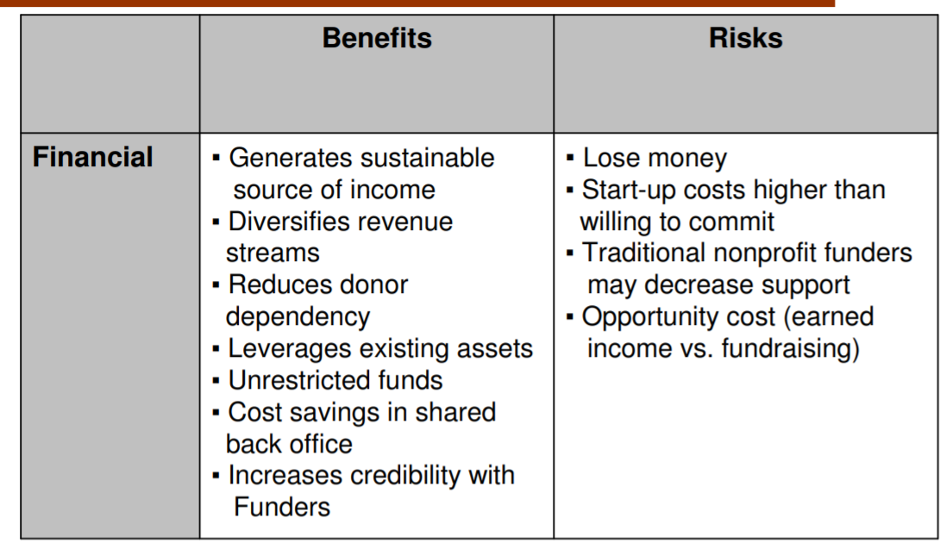
Benefits & Risks of Social Enterprise

Slide 12
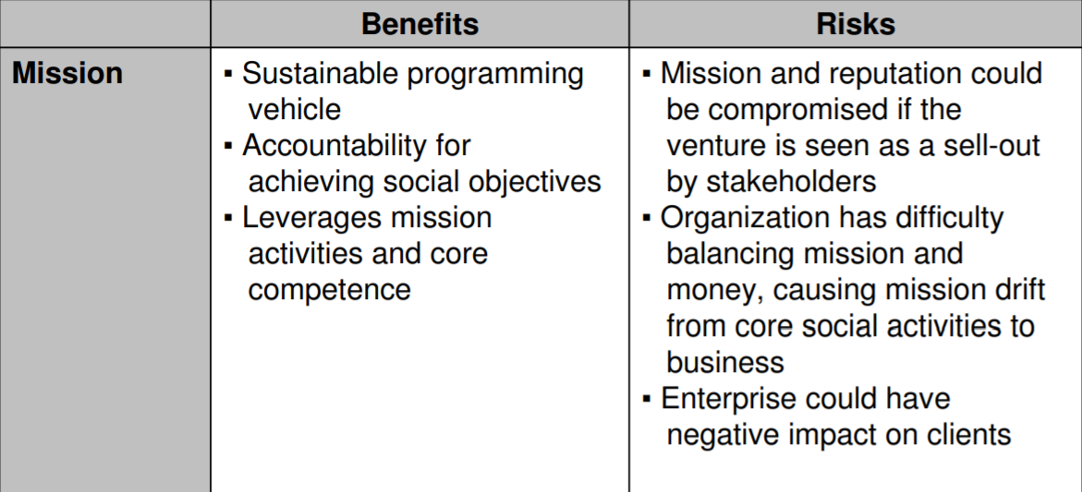
Benefits & Risks of Social Enterprise

Slide 13
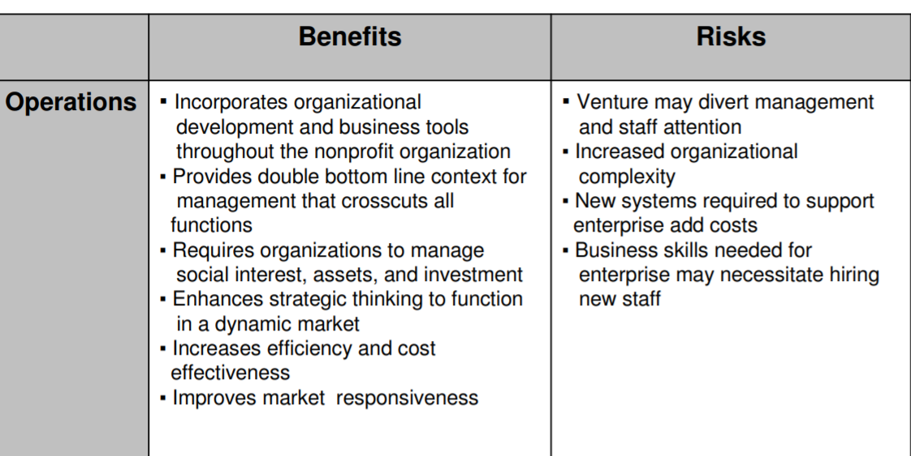
Benefits & Risks of Social Enterprise

Slide 14
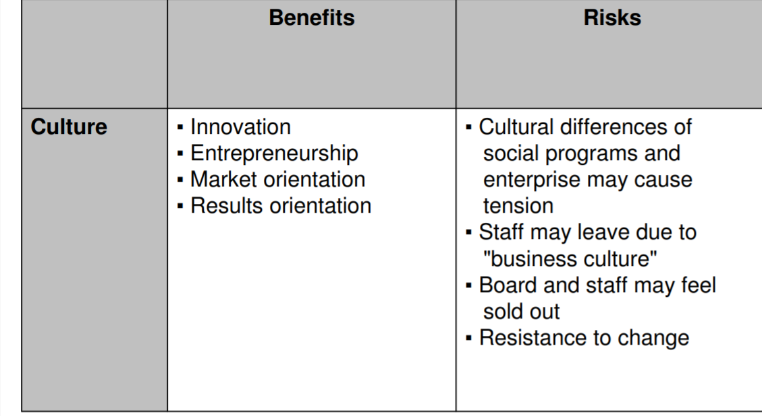
Benefits & Risks of Social Enterprise

Slide 15
Legal Framework
For each project to extract natural resources from the ground, there are rules that govern the rights and responsibilities of governments, companies, and citizens. Together these rules are called a legal framework, or legal architecture.
A well-designed legal architecture should provide rules for how state institutions are structured; how companies acquire and manage licenses; the fiscal terms governing payments between companies and the state; environmental management; relationships between extractive projects and neighboring communities; the behavior of public officials active in the sector; public information disclosure and accountability and how the government will manage natural resource revenues.
Legal frameworks comprise a set of documents that include the constitution, legislation, regulations, and contracts.
The most common types of business entities include sole proprietorships, partnerships, limited liability companies, corporations and cooperatives. Here's more about each type of legal structure.

Slide 16
Legal Framework
1.Sole proprietorship
This is the simplest form of business entity. With a sole proprietorship, one person is responsible for all company's profits and debts.
2. Partnership
This entity is owned by two or more individuals. There are two types: a general partnership, where all is shared equally; and a limited partnership, where only one partner has control of its operation while the other person (or persons) contributes to and receives part of the profits. Partnerships carry a dual status as a sole proprietorship or limited liability partnership (LLP), depending on the entity's funding and liability structure.
3. Limited liability company
A limited liability company (LLC) is a hybrid structure that allows owners, partners or shareholders to limit their personal liabilities while enjoying the tax and flexibility benefits of a partnership. Under an LLC, members are shielded from personal liability for the debts of the business if it cannot be proven that they acted in an illegal, unethical or irresponsible manner in carrying out the activities of the business.

Slide 17
Legal Framework
4. Corporation
The law regards a corporation as an entity separate from its owners
5. Cooperative
A cooperative (co-op) is owned by the same people it serves. Its offerings benefit the company's members, also called user-owners, who vote on the organization's mission and direction and share profits. Advantages that cooperatives offer include:
Lower taxes. Like an LLC, a cooperative doesn't tax its members on their income.
Increased funding. Cooperatives may be eligible for federal grants that help them get started.
Discounts and better service. Cooperatives can leverage their business size, thus obtaining discounts on products and services for their members.

